Slide 1
Representing Relations
Epp section ???
CS 202
Aaron Bloomfield

Slide 2
In this slide set…
Matrix review
Two ways to represent relations
  Via matrices
  Via directed graphs

Slide 3
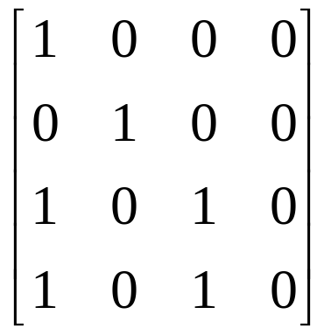
Matrix review
We will only be dealing with zero-one matrices
  Each element in the matrix is either a 0 or a 1
These matrices will be used for Boolean operations
  1 is true, 0 is false

Slide 4
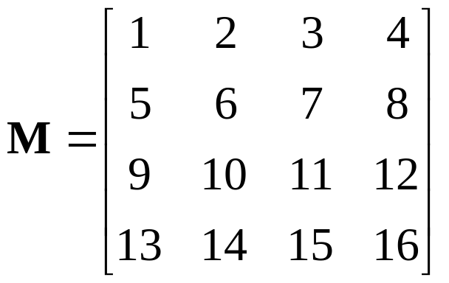
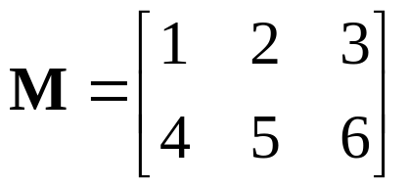
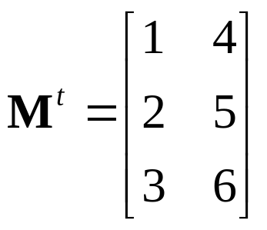
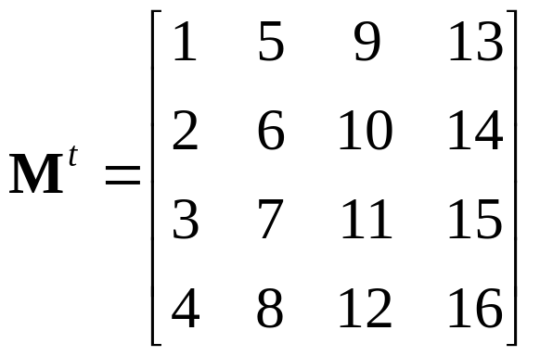
Matrix transposition
Given a matrix M, the transposition of M, denoted M^{t}, is the matrix obtained by switching the columns and rows of M
In a “square” matrix, the main
diagonal stays unchanged

Slide 5
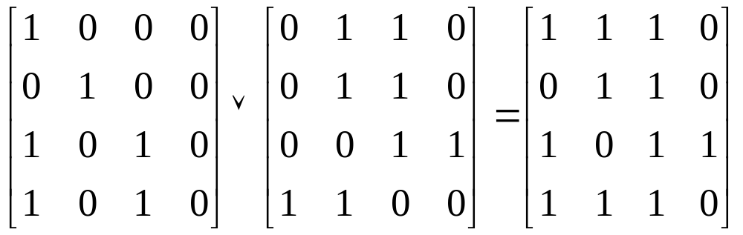
Matrix join
A join of two matrices performs a Boolean OR on each relative entry of the matrices
  Matrices must be the same size
  Denoted by the or symbol: ∨

Slide 6
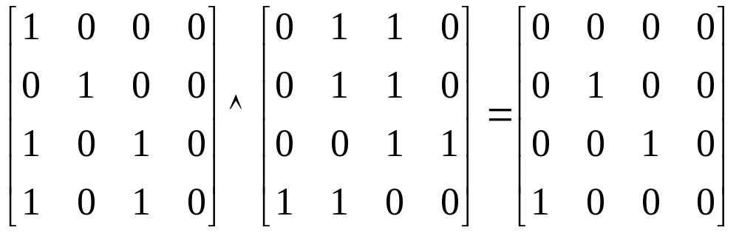
Matrix meet
A meet of two matrices performs a Boolean AND on each relative entry of the matrices
  Matrices must be the same size
  Denoted by the or symbol: ∧

Slide 7
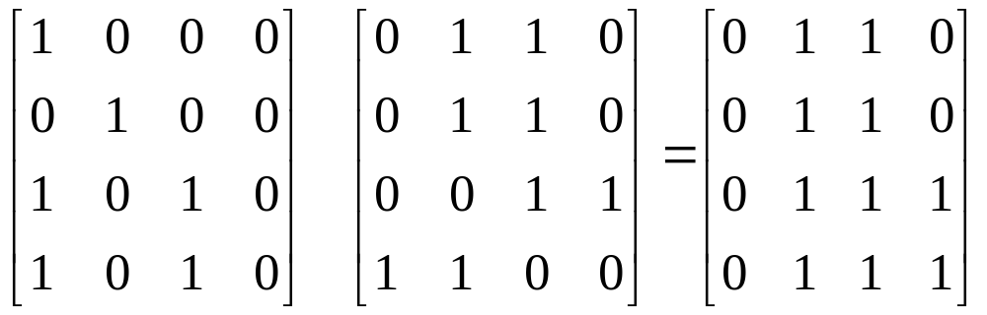
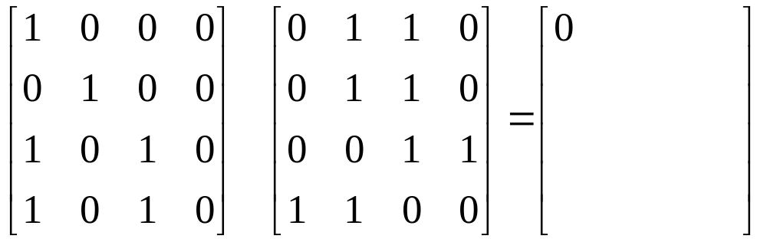
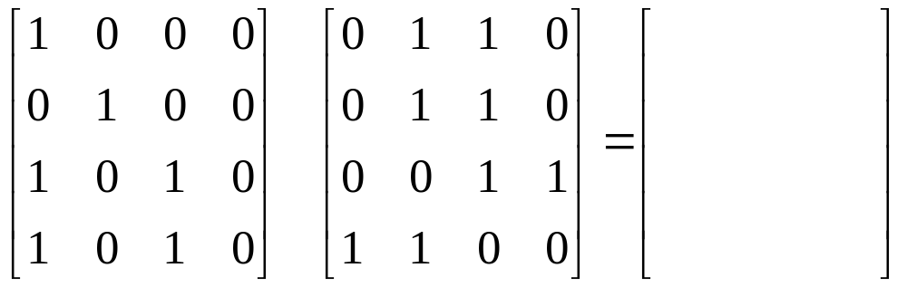
Matrix Boolean product
A Boolean product of two matrices is similar to matrix multiplication
  Instead of the sum of the products, it’s the conjunction (and) of the disjunctions (ors)
  Denoted by the or symbol:
⋅

Slide 8
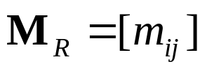
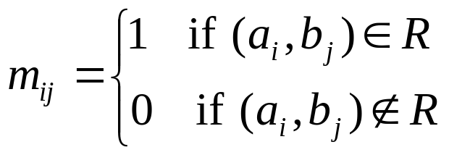
Relations using matrices
List the elements of sets A and B in a particular order
  Order doesn’t matter, but we’ll generally use ascending order
Create a matrix

Slide 9
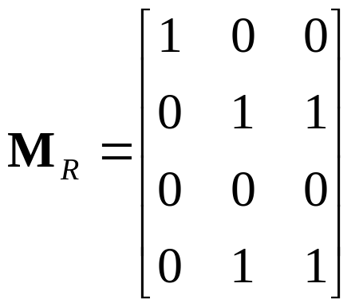
Relations using matrices
Consider the relation of who is enrolled in which class
  Let A = { Alice, Bob, Claire, Dan }
  Let B = { CS101, CS201, CS202 }
  R = { (a,b) | person a is enrolled in course b }
 | CS101 | CS201 | CS202
Alice | X
Bob |  | X | X
Claire
Dan |  | X | X

Slide 10
Relations using matrices
What is it good for?
  It is how computers view relations
    A 2-dimensional array
  Very easy to view relationship properties
We will generally consider relations on a single set
  In other words, the domain and co-domain are the same set
  And the matrix is square

Slide 11
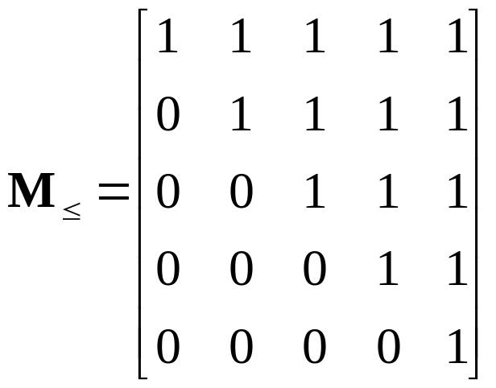
Reflexivity
Consider a reflexive relation: ≤
  One which every element is related to itself
  Let A = { 1, 2, 3, 4, 5 }
If the center (main) diagonal is all 1’s, a relation is reflexive

Slide 12
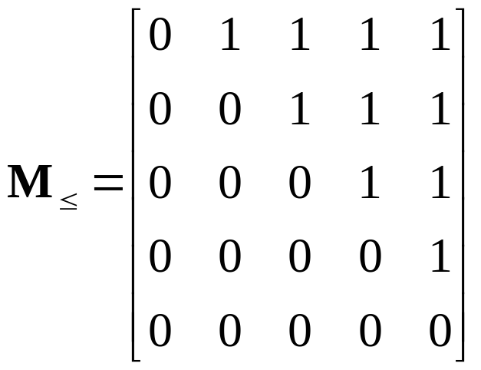
Irreflexivity
Consider a reflexive relation: <
  One which every element is not related to itself
  Let A = { 1, 2, 3, 4, 5 }
If the center (main) diagonal is all 0’s, a relation is irreflexive

Slide 13
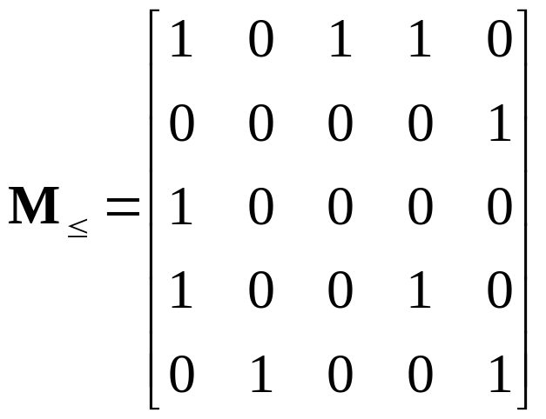
Symmetry
Consider an symmetric relation R
  One which if a is related to b then b is related to a for all (a,b)
  Let A = { 1, 2, 3, 4, 5 }
If, for every value, it is the equal to the value in its transposed position, then the relation is symmetric

Slide 14
Asymmetry
Consider an asymmetric relation: <
  One which if a is related to b then b is not related to a for all (a,b)
  Let A = { 1, 2, 3, 4, 5 }
If, for every value and the value in its transposed position, if they are not both 1, then the relation is asymmetric
An asymmetric relation must also be irreflexive
Thus, the main diagonal must be all 0’s

Slide 15
Antisymmetry
Consider an antisymmetric relation: ≤
  One which if a is related to b then b is not related to a unless a=b for all (a,b)
  Let A = { 1, 2, 3, 4, 5 }
If, for every value and the value in its transposed position, if they are not both 1, then the relation is antisymmetric
The center diagonal can have both 1’s and 0’s

Slide 16
Transitivity
Consider an transitive relation: ≤
  One which if a is related to b and b is related to c then a is related to c for all (a,b), (b,c) and (a,c)
  Let A = { 1, 2, 3, 4, 5 }
If, for every spot (a,b) and (b,c) that each have a 1, there is a 1 at (a,c), then the relation is transitive
Matrices don’t show this property easily

Slide 17
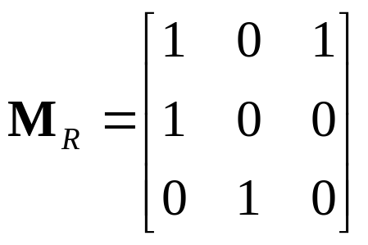
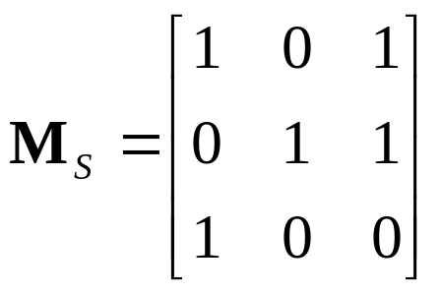
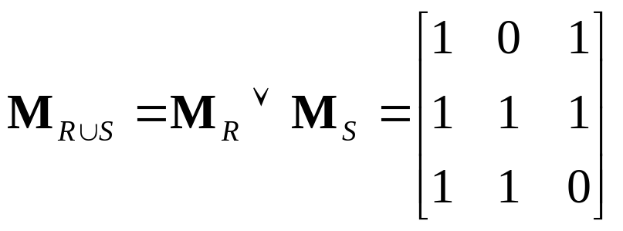
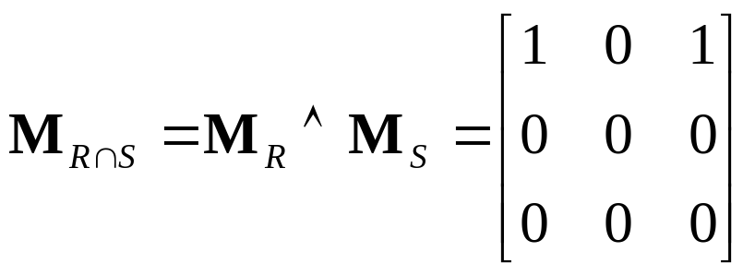
Combining relations: via Boolean operators
Let:
Join:
Meet:

Slide 18
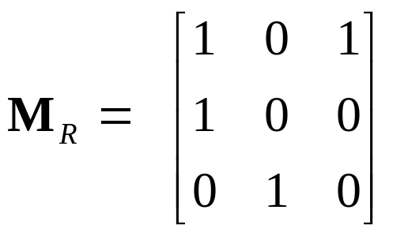
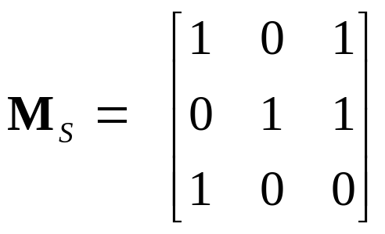
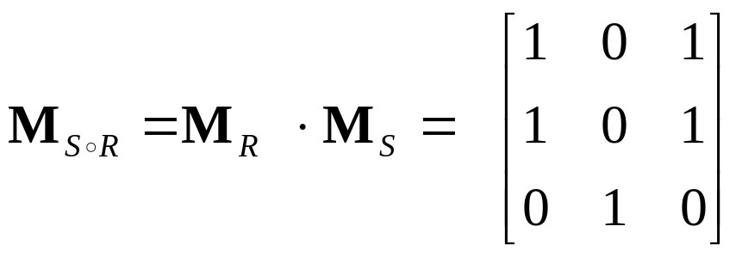
Combining relations: via relation composition
Let:
But why is this the case?
d e f
g h i
a
b
c
d
e
f
g h i
a
b
c

Slide 19
Representing relations using directed graphs
A directed graph consists of:
  A set V of vertices (or nodes)
  A set E of edges (or arcs)
  If (a, b) is in the relation, then there is an arrow from a to b
Will generally use relations on a single set
Consider our relation R = { (a,b) | a divides b }
Old way:
1
2
3
4
1
2
3
4
1
2
3
4

Slide 20
Reflexivity
Consider a reflexive relation: ≤
  One which every element is related to itself
  Let A = { 1, 2, 3, 4, 5 }
1
2
If every node has a loop, a relation is reflexive
5
3
4

Slide 21
Irreflexivity
Consider a reflexive relation: <
  One which every element is not related to itself
  Let A = { 1, 2, 3, 4, 5 }
1
2
If every node does not have a loop, a relation is irreflexive
5
3
4

Slide 22
Symmetry
Consider an symmetric relation R
  One which if a is related to b then b is related to a for all (a,b)
  Let A = { 1, 2, 3, 4, 5 }
If, for every edge, there is an edge in the other direction, then the relation is symmetric
Loops are allowed, and do not need edges in the “other” direction
1
2
Called anti-
parallel pairs
5
3
4
Note that this relation is neither reflexive nor irreflexive!

Slide 23
Asymmetry
Consider an asymmetric relation: <
  One which if a is related to b then b is not related to a for all (a,b)
  Let A = { 1, 2, 3, 4, 5 }
A digraph is asymmetric if:
If, for every edge, there is not an edge in the other direction, then the relation is asymmetric
Loops are not allowed in an asymmetric digraph (recall it must be irreflexive)
1
2
5
3
4

Slide 24
Antisymmetry
Consider an antisymmetric relation: ≤
  One which if a is related to b then b is not related to a unless a=b for all (a,b)
  Let A = { 1, 2, 3, 4, 5 }
If, for every edge, there is not an edge in the other direction, then the relation is antisymmetric
Loops are allowed in the digraph
1
2
5
3
4

Slide 25
Transitivity
Consider an transitive relation: ≤
  One which if a is related to b and b is related to c then a is related to c for all (a,b), (b,c) and (a,c)
  Let A = { 1, 2, 3, 4, 5 }
A digraph is transitive if, for there is a edge from a to c when there is a edge from a to b and from b to c
1
2
5
3
4

Slide 26
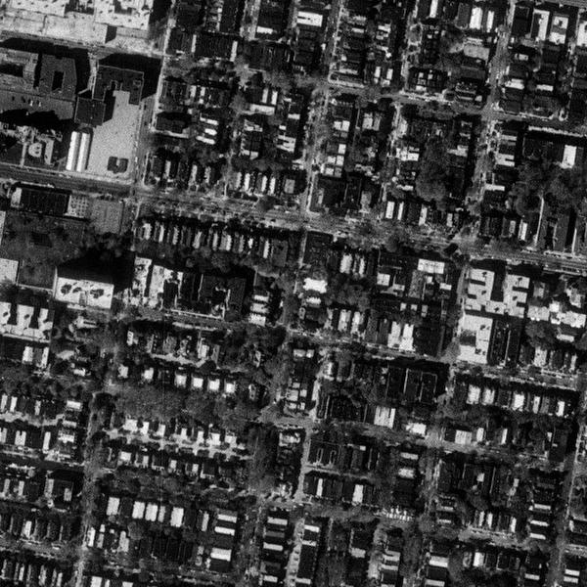
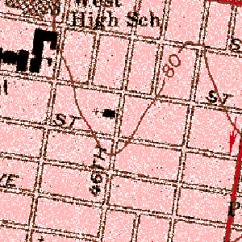
Applications of digraphs: MapQuest
Not reflexive
Is irreflexive
Not symmetric
Not asymmetric
Not antisymmetric
Not transitive
End
Not reflexive
Is irreflexive
Is symmetric
Not asymmetric
Not antisymmetric
Not transitive
Start

Slide 27
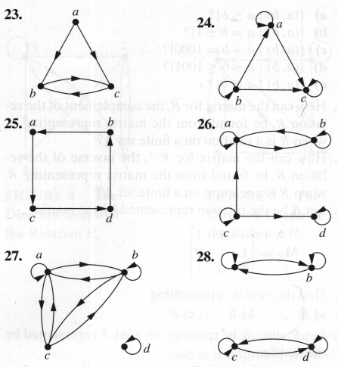
Sample questions
Which of the graphs are reflexive, irreflexive, symmetric, asymmetric, antisymmetric, or transitive
 | 23 | 24 | 25 | 26 | 27 | 28
Reflexive |  | Y |  | Y |  | Y
Irreflexive | Y |  | Y
Symmetric |  |  |  |  | Y | Y
Asymmetric |  |  | Y
Anti-symmetric |  | Y | Y
Transitive |  |  |  |  |  | Y

Slide 28
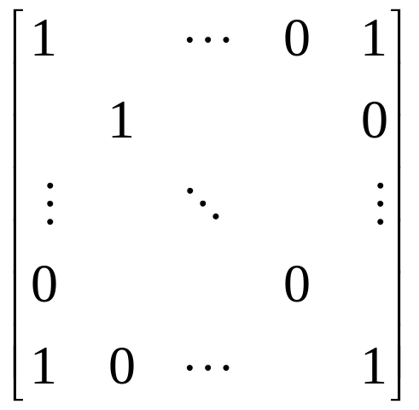


How many symmetric relations are there on a set with n elements?
Consider the matrix representing symmetric relation R on a set with n elements:
The center diagonal can have any values
Once the “upper” triangle is determined,
the “lower” triangle must be the transposed
version of the “upper” one
How many ways are there to fill in the center
diagonal and the upper triangle?
There are n² elements in the matrix
There are n elements in the center diagonal
  Thus, there are 2^{n} ways to fill in 0’s and 1’s in the diagonal
Thus, there are (n²-n)/2 elements in each triangle
  Thus, there are ways to fill in 0’s and 1’s in the triangle
Answer: there are possible symmetric relations on a set with n elements

